Slide 1
Catalyst
Interface critique and redesign target
Finding classes and enrolling with confidence
Aayush Keshari, Nipun Chandra, Shivam Kharangate
Notes:
TIMING: 0:00–0:25
SPEAKING SCRIPT
I chose Catalyst because it supports decisions that directly affect my semester, especially finding and registering for classes. As a UC student, I want to focus on choosing the right courses. My critique is that the interface also makes me work out where to go, what happened, and how to recover when something goes wrong.
SOURCES AND EVIDENCE
Presenter’s motivation and interpretation of the supplied class critique.

Slide 2
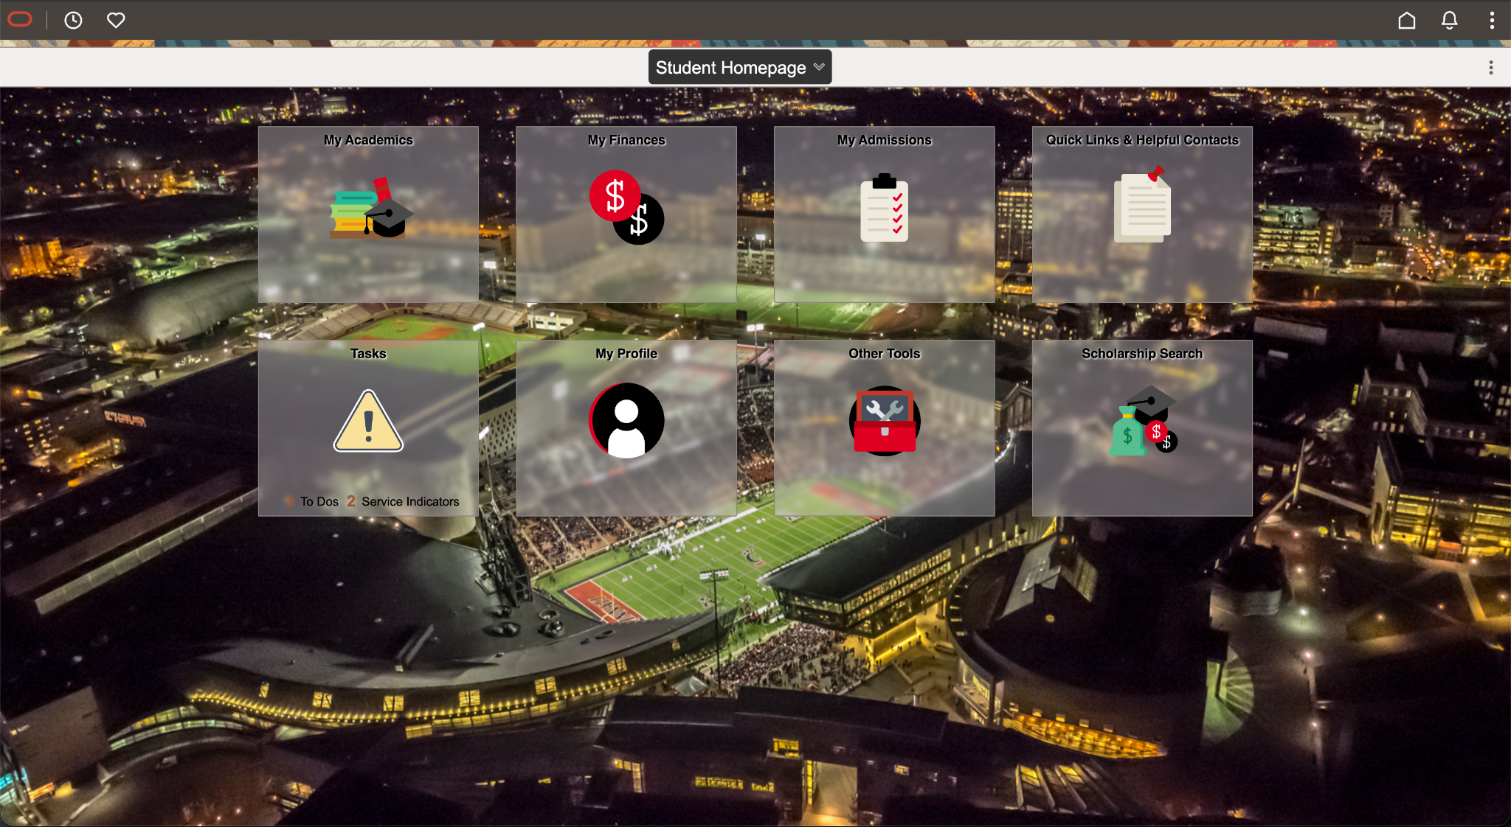
What Catalyst does
UC’s student portal
Academic and administrative tasks in one portal.
Critique focus
Class search and enrollment
Evidence: supplied screens and class critique. Reported bugs need reproduction.
02
Notes:
TIMING: 0:25–0:55
SPEAKING SCRIPT
Catalyst is UC’s student portal for academic and administrative tasks. The homepage groups functions into areas such as My Academics, My Finances, and Tasks. That grouping is a useful starting point. My focus is the class search and enrollment experience. The evidence here comes from the supplied screenshots and classmates’ heuristic critiques. Those comments identify problems worth investigating, but they do not establish how often every student encounters them.
SOURCES AND EVIDENCE
Supplied homepage screenshot, 6:12:36 PM.
https://www.cech.uc.edu/student-services/student-services-center/what-is-advising/academic-planning-tools/registering-for-classes-.html

Slide 3
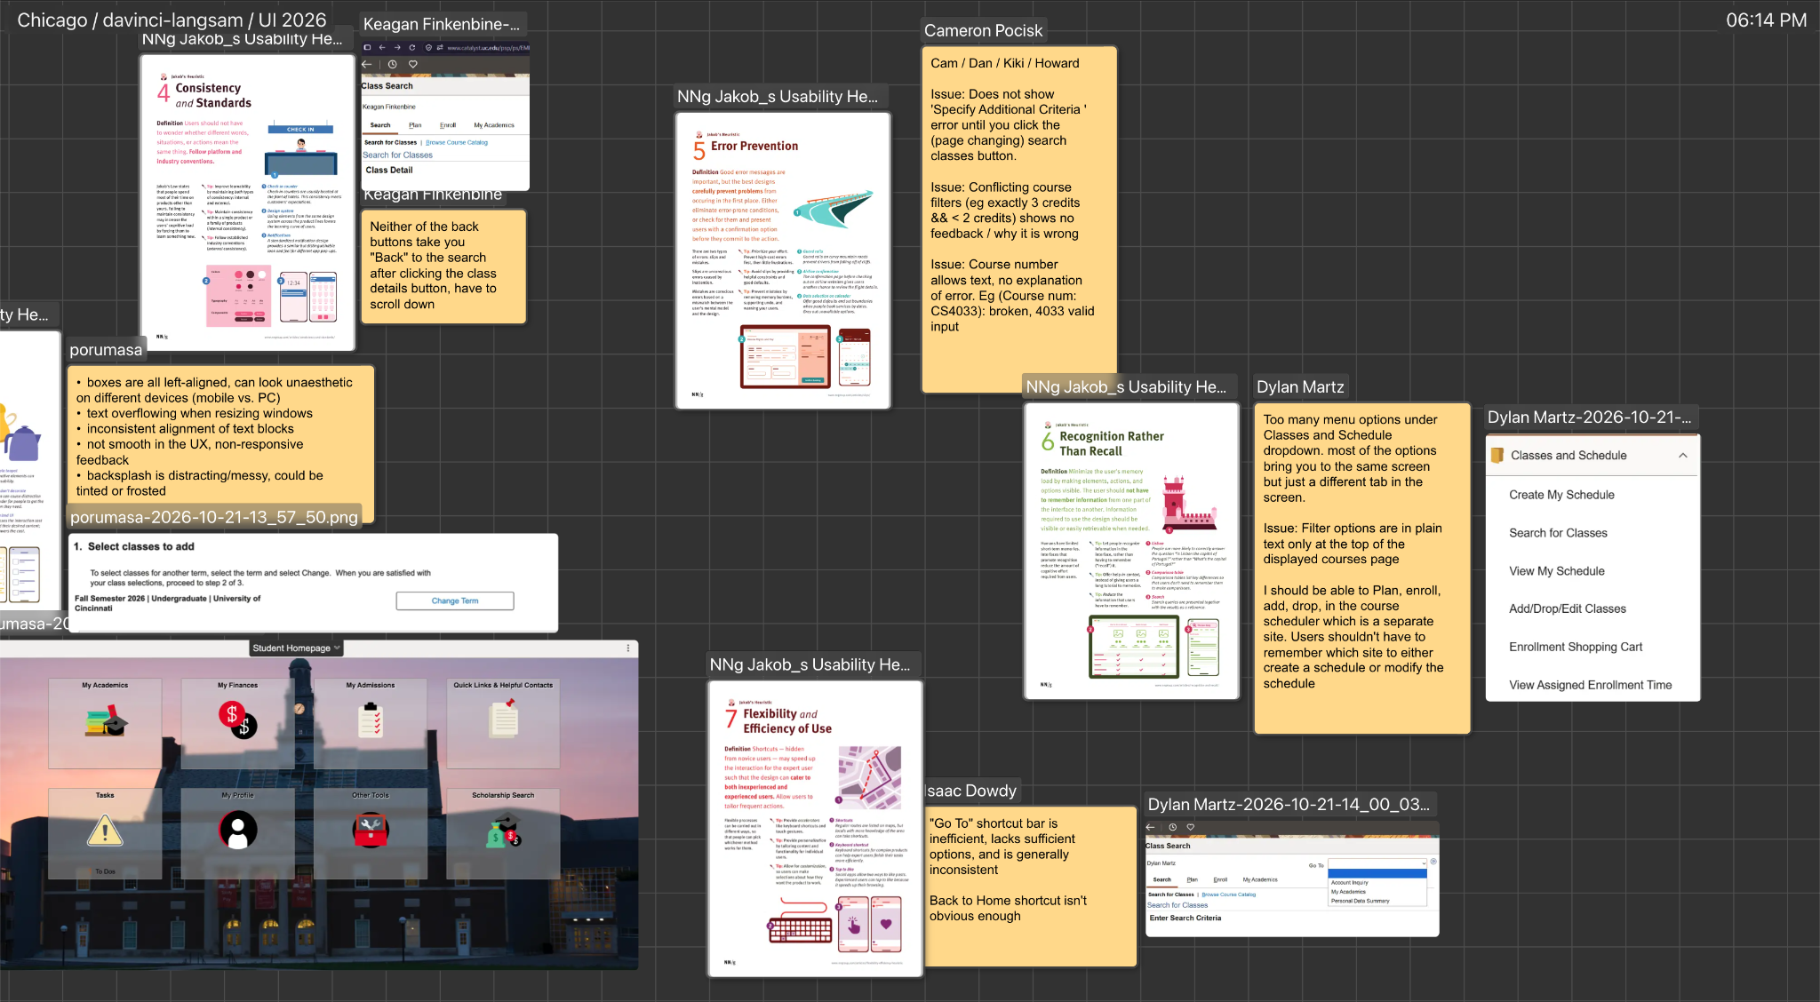
Task 1: Find a class
1 Open My Academics
2 Choose Classes and Schedule
3 Search for Classes
4 Set criteria and inspect a section
Goal: compare sections without rebuilding the search.
Workflow: UC advising guidance. Navigation problems: class critique reports.
03
Notes:
TIMING: 0:55–1:30
SPEAKING SCRIPT
The first task is finding a class that fits a student’s requirements. Start in My Academics, open Classes and Schedule, and choose Search for Classes. Select the term and enter criteria such as subject and course number, then inspect a section’s details. The important interaction is going back to compare another section. Classmates reported that the available back controls did not reliably restore the search, and filters did not persist. That can turn a simple comparison into repeated searching and re-entering information.
SOURCES AND EVIDENCE
Supplied 6:14:19 PM screenshot: Classes and Schedule menu.
Reported behavior: Colin Davis and Keagan Finkenbine, supplied critique boards.
https://www.cech.uc.edu/student-services/student-services-center/what-is-advising/academic-planning-tools/registering-for-classes-.html

Slide 4
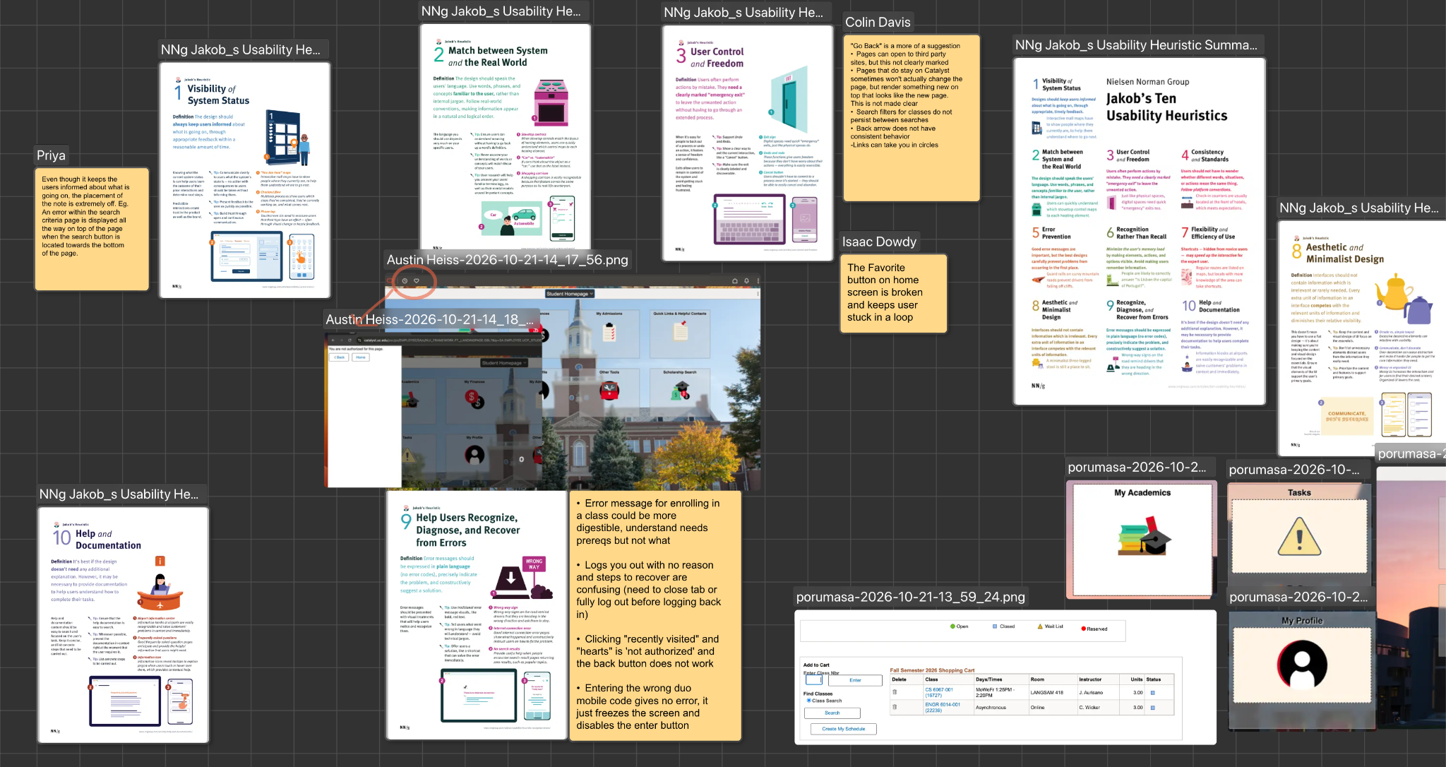
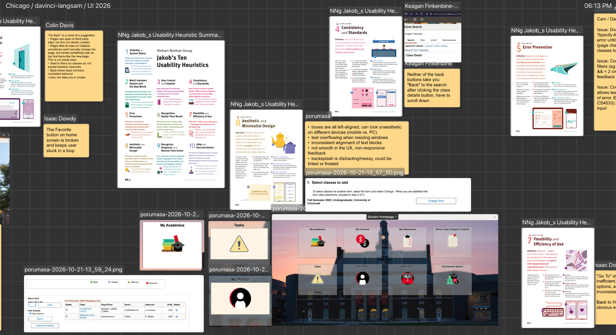
Task 2: Enroll in a class
1 Add a section to the cart
2 Complete enrollment when eligible
3 Review the result
4 Verify your class schedule
The cart holds selected sections
A saved selection does not reserve a seat.
UC distinguishes saved selections from completed registration.
04
Notes:
TIMING: 1:30–2:05
SPEAKING SCRIPT
The second task is enrolling. After choosing a section, the student adds it to the enrollment shopping cart. At the assigned enrollment time, they complete enrollment, review the result, and check their schedule. A cart entry only saves a selection. It does not secure enrollment. Catalyst also offers Create My Schedule as a planning route. Moving between planning, the cart, and enrollment creates several states to understand. The redesign should make the current state and the next required action unmistakable.
SOURCES AND EVIDENCE
Supplied 6:13:31 PM screenshot: shopping cart. Supplied 6:14:04 PM screenshot: select classes step.
https://www.cech.uc.edu/student-services/student-services-center/what-is-advising/academic-planning-tools/registering-for-classes-.html
https://www.uc.edu/about/registrar/registration/registration-how-to-guide.html

Slide 5
Navigation increases the learning burden
Similar labels, different destinations
Students must remember which menu or tool performs each action.
Unpredictable return paths
Reported back-button loops and lost filters interrupt comparisons.
Learnability: recognition, consistency, and user control
Reported behavior in the supplied class critique. Screens show tabs and shortcuts.
05
Notes:
TIMING: 2:05–2:45
SPEAKING SCRIPT
Several navigation choices describe similar goals: create a schedule, view a schedule, add or drop classes, and open the shopping cart. Classmates reported that some choices lead to different tabs in the same screen, while others open separate tools without clearly announcing the change. The interface makes students remember which route performs which action. Inconsistent back behavior makes exploration harder to reverse. This conflicts with recognition rather than recall, consistency, and user control. Clear task labels and preserved context would make the workflow easier to learn.
SOURCES AND EVIDENCE
Reported behavior: Colin Davis, Dylan Martz, Keagan Finkenbine, and Isaac Dowdy in supplied screenshots.
https://www.nngroup.com/articles/ten-usability-heuristics/

Slide 6
Recovery can become another task
Reported in the class critique
Favorites and history can lead to loops
Unexpected logout has unclear recovery
Prerequisite errors lack useful detail
Wrong Duo code can leave the screen stuck
“You are not authorized for this page.”
A useful error explains the cause and offers the next action.
Behavior reports need reproduction. The authorization message is visible in the supplied image.
07
Notes:
TIMING: 3:25–4:05
SPEAKING SCRIPT
Recovery is another concern. The screenshots include an authorization message, and classmates reported that Favorites and Recently Visited could lead into loops or leave the back control unhelpful. They also reported unexpected logouts, unclear prerequisite errors, and an incorrect Duo code leaving the interface unresponsive. These reports still need reproduction. The design requirement is clear: explain the problem, identify a useful next action, and preserve safe progress. For example, an enrollment error should name the unmet requirement and link to the relevant help.
SOURCES AND EVIDENCE
Supplied 6:13:31 PM screenshot: authorization message and error-recovery note. Favorites report: Isaac Dowdy.
https://www.uc.edu/about/registrar/registration/registration-how-to-guide.html
https://www.nngroup.com/articles/ten-usability-heuristics/

Slide 7
The visual design competes with the task
Competing emphasis
Busy photo behind translucent tiles
Small labels and little urgency hierarchy
Reported overflow on resize
Keep the recognizable categories and large click targets.
08
Notes:
TIMING: 4:05–4:40
SPEAKING SCRIPT
The homepage has recognizable categories and large targets, but the campus photograph competes with translucent tiles and small labels. Similar visual emphasis makes a routine category and an urgent task look equally important. Classmates also reported text overflow and inconsistent alignment when resizing. Left alignment itself is useful. The issue is whether spacing and content remain consistent across sizes. A calmer background, clearer type hierarchy, and prominent deadlines would make the homepage easier to scan.
SOURCES AND EVIDENCE
Direct visual inspection of supplied homepage screenshots. Resize and alignment reports: pourumasa, supplied 6:14:04 and 6:14:19 PM screenshots.
https://www.nngroup.com/articles/ten-usability-heuristics/

Slide 8
Redesign priorities
Priority | Proposed change | Why it matters
1 Complete the workflow | Connect search, comparison, cart, and enrollment | Preserve context and clarify status
2 Prevent and explain errors | Validate fields early and give specific recovery steps | Reduce avoidable retries
3 Improve scanning | Prioritize deadlines with clear text and a calmer layout | Make important actions easier to find
Prototype scope: academic home, search/results, and enrollment feedback.
09
Notes:
TIMING: 4:40–5:15
SPEAKING SCRIPT
I would start with the academic workflow. First, create one coherent place to find classes, compare sections, manage a cart, and see enrollment results. Preserve filters and provide a predictable return to results. Next, prevent invalid searches and give actionable feedback beside each problem. Then simplify the homepage around upcoming actions and deadlines. This is a fundamental redesign because it changes how tasks connect and how the system communicates progress. The visual cleanup supports those changes.
SOURCES AND EVIDENCE
Proposed design priorities derived from supplied critiques. These are hypotheses, not measured improvements.

Slide 9
What a successful redesign should prove
Heuristic review + think-aloud tasks
Observe completion, wrong turns, repeated inputs,
and understanding of enrollment status.
Students should understand the next step
and know when the task is complete.
Proposed validation. No measured improvement claimed.
10
Notes:
TIMING: 5:15–5:45
SPEAKING SCRIPT
Next, I would combine the heuristic evaluation with a think-aloud study using these same two tasks. I would record completion, wrong turns, repeated inputs, and whether students correctly understand their enrollment status. Then I would compare the prototype with the current workflow. My goal is for a student to find a class, enroll, and recover from mistakes without needing to memorize how Catalyst is organized.
SOURCES AND EVIDENCE
Proposed research only. No participant study or measured improvement has been completed for this presentation.
Project 2 brief requires at least two research methods.

